Slide 1
Phase 2 Demo
BY: The Creators

Slide 2
Connect Four
First player to achieve four pieces in a row wins

Slide 3
Phase 2 Accomplishments
Faster min max algorithm
Color selector
Text box message display

Slide 4
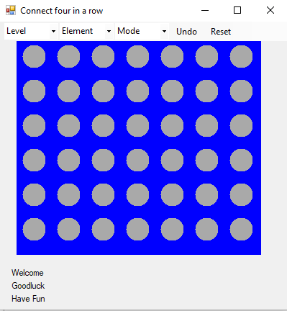
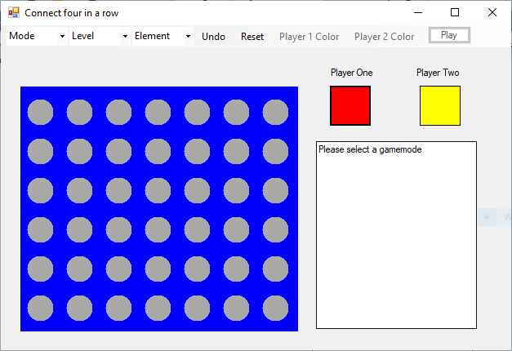

Slide 5
Challenges
Speed of game
Color selector
Not getting beat by the AI (Anthony)

Slide 6
Color Code
Color customization for game pieces
Color dialog allows user to select from an abundance of different colors
Once a color is selected, it is assigned to a brush
The movePainter() method then utilizes this brush to paint the piece on the board

Slide 7
Error Handling Codes
Added error handling in phase two
Players cannot use the same color
Pieces cannot be placed until game setup is complete
Players cannot use the colors Grey or Blue as they interfere with gameplay
Gamestate textbox has been added to walk players through gamesetup
Gamestate textbox also gives live feed of moves being made on the gameboard

Slide 8
Sounds
Final touch of phase two, which adds some liveliness to the game
When a move is made a sound is played according to player
Still working on implementing sounds for errors, UI interaction, WIN, and LOSS

Slide 9
Questions?

